Slide 1
Dave Gudgel – “U Could B” - Colossians 2:1-7

Slide 2
Dave Gudgel – “U Could B” - Colossians 2:1-7

Slide 5
UCB
U

Slide 7
This is
U

Slide 8
This is
U
Firm but Vulnerable

Slide 10
This is what
UCB
This is
U

Slide 11
In Encouraging Community
Increasing in Wisdom
Close to Christ
Secure in Your Faith

Slide 12
This is what
Rock solid and thriving
UCB
This is
U

Slide 13
What’s Required?
This is what
Rock solid and thriving
UCB
This is
U

Slide 14
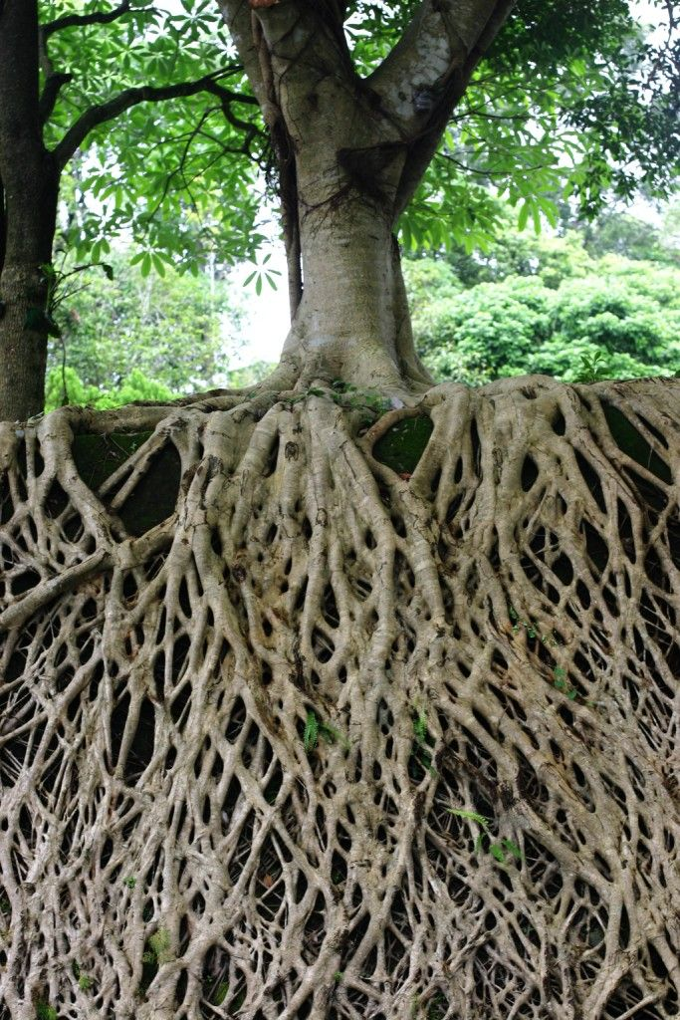
Go Deep

Slide 15
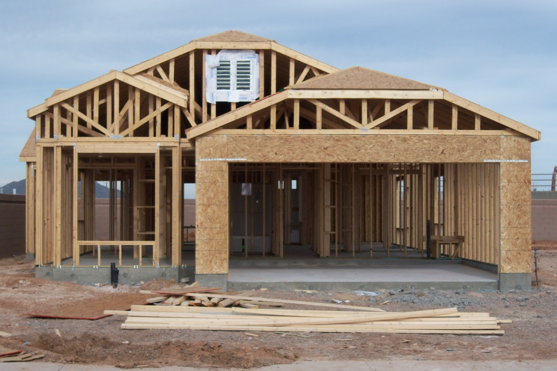
Keep Building

Slide 16
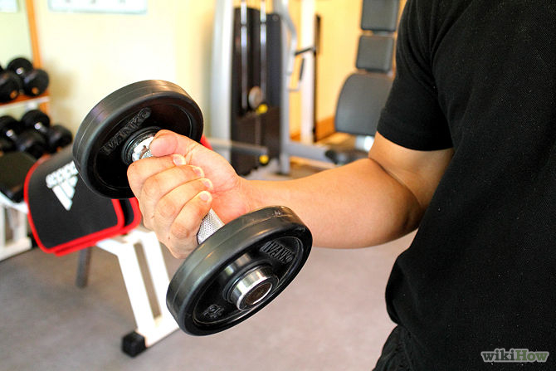
Get Stronger

Slide 17
Hebrews 4:16
Let us then approach the throne of grace with confidence, so that we may receive mercy and find grace to help us in our time of need.

Slide 18
“One day I was in trouble and oppressed about many things. It was one of those days when everything seemed to go wrong. I was trying to get my quiet time but was constantly interrupted. Suddenly these words came—I could hardly believe they were in the Bible,

Slide 19
they seemed so new to my needy heart—“Grace to help in time of need.” I found them and read them and marked them with joy, and in that moment, the moment of their coming, I was renewed in strength.
- Amy Carmichael

Slide 20
Live Thankful

Slide 22
In Encouraging Community
Increasing in Wisdom
Close to Christ
Secure in Your Faith

Slide 23
Go Deeper
Keep Building
Get Stronger
Live Thankful

Slide 26
Dave Gudgel – “U Could B” - Colossians 2:1-7

Slide 27
BRAD COLE HOST

Slide 28
SARAH SUN HOST

Slide 29
CARRIE MILLER HOST

Slide 30
EDDIE HUANG HOST

Slide 31
NANCY BILDERBACK ASSISTANT TO WORSHIP MINISTRIES, AND FINANCIAL SECRETARY

Slide 32
TIM LOGAN HOST

Slide 33
DAVE STENFORT HOST

Slide 34
SCOTT RIKIMARU HOST

Slide 35
STEVE DURAND PASTOR OF FAMILY MINISTRIES

